Slide 1


Fine-grained visual classification of aircraft
Vuong Dinh An

Slide 2
About the presenter
I’m in my final year at Hanoi University of Science and Technology. I’m studying Bachelor of Computer Science in Talented Program.
I used to research in Evolutionary Algorithm and had a publication.
I have switched to Reinforcement Learning for almost a year. I completed the Reinforcement Learning Specialization (includes 4 courses) on Coursera.
I have an enthusiasm for AI/ML/DL and I want to become a ML expert in the future.

Slide 3
ML experiences
Build an intelligent chatbot with Transformer.
Bank-churn prediction using ML methods.
Weakly supervised semantic segmentation.
Minimize energy depletion in WRSN using Deep Q-Learning and GraphSAGE.¹
1 This is also my current thesis

Slide 4

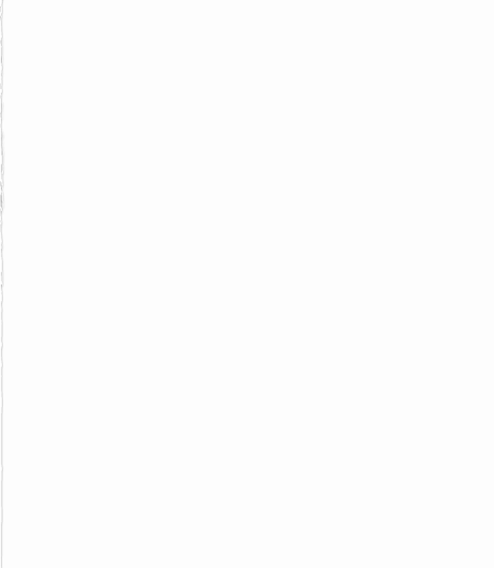
FGVC of aircraft
1. Introduction
2. Related work
3. Methodology
4. Experiment
5. Discussion

Slide 5
1. Introduction
In recent years, CNNs has gained public attention due to various success. [1]
In CNNs, extensive computation is one of the major drawbacks that could prevent from practical applications.
However, thanks to transfer learning, CNNs can save a lot of computation by transferring knowledge from a huge domain to a much smaller one. [2]
[1] Kaiming He, Xiangyu Zhang, Shaoqing Ren, and Jian Sun. Deep residual learning for image recognition. In Proceedings of the IEEE conference on computer vision and pattern recog- nition, pages 770–778, 2016
[2] Li Xuhong, Yves Grandvalet, and Franck Davoine. Explicit inductive bias for transfer learning with convolutional net- works. In International Conference on Machine Learning, pages 2825–2834. PMLR, 2018

Slide 6
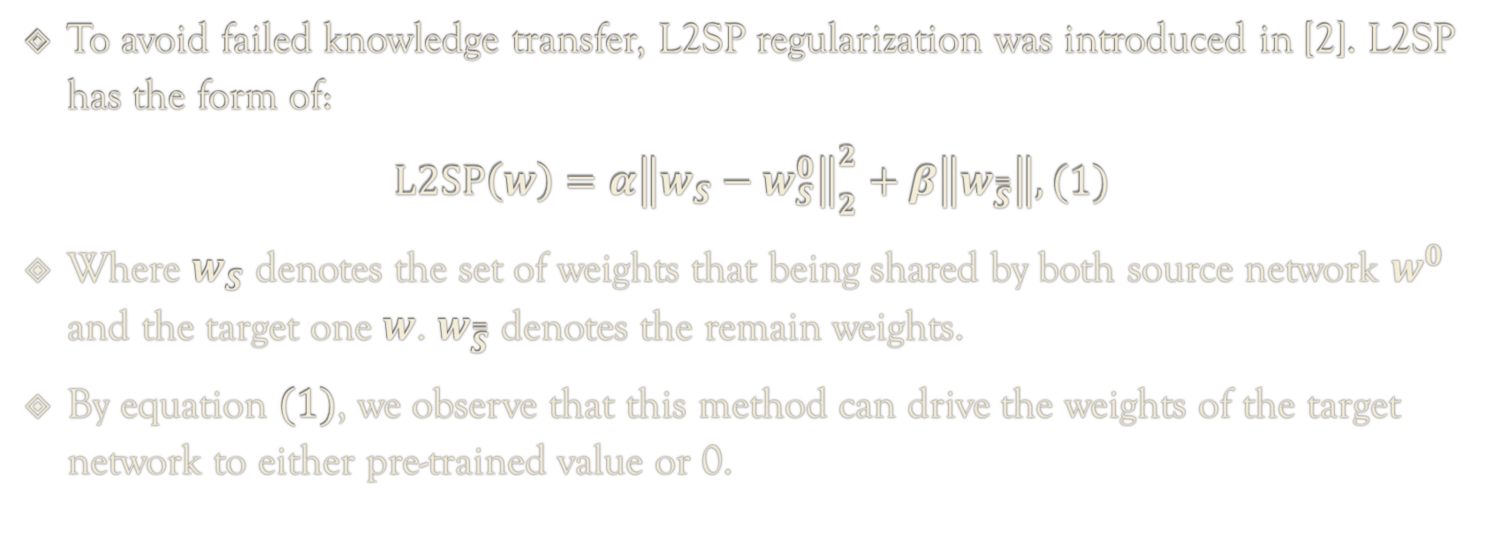
1. Introduction
To avoid failed knowledge transfer, L2SP regularization was introduced in [2]. L2SP has the form of:
$$L2SP\left(w\right)=α{\left\|w_{S}−w_{S}^{0}\right\|}_{2}^{2}+β\left\|w_{\overset{̿}{S}}\right\|, (1)$$
Where $w_{S}$ denotes the set of weights that being shared by both source network $w^{0}$ and the target one $w$. $w_{\overset{̿}{S}}$ denotes the remain weights.
By equation $(1)$, we observe that this method can drive the weights of the target network to either pre-trained value or 0.

Slide 7
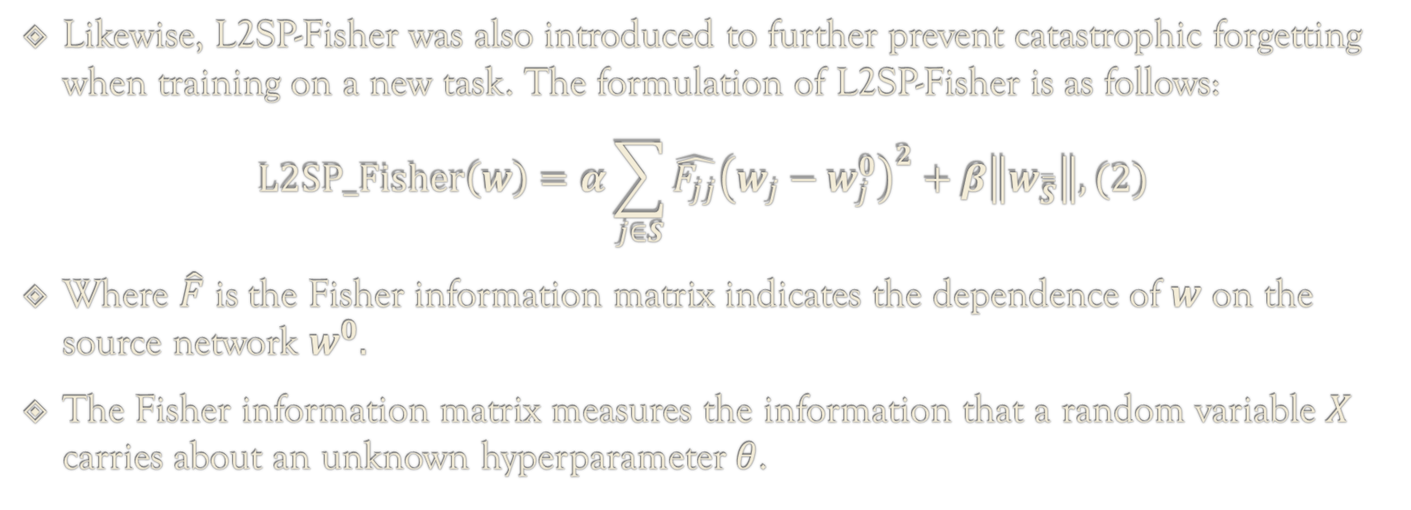
1. Introduction
Likewise, L2SP-Fisher was also introduced to further prevent catastrophic forgetting when training on a new task. The formulation of L2SP-Fisher is as follows:
$$L2SP_Fisher\left(w\right)=α\sum_{j∈S}{{\hat{F_{jj}}\left(w_{j}−w_{j}^{0}\right)}^{2}}+β\left\|w_{\overset{̿}{S}}\right\|, (2)$$
Where $\hat{F}$ is the Fisher information matrix indicates the dependence of $w$ on the source network $w^{0}.$
The Fisher information matrix measures the information that a random variable $X$ carries about an unknown hyperparameter $θ$.

Slide 8
1. Introduction
Therefore, this project aims to study the assumptions on L2SP and L2SP-Fisher to know whether they are good for transferring learning on a task that were proved to be difficult, which is Fine-grained visual classification of aircraft.

Slide 9
2. Related work
Originally, to improve the performance in transfer learning, researchers studied the impact of growing number of transferred layers. [3]
After the remarkable breakthrough of residual networks [1], the techniques had varied.
One of the trend for enhancing performance of transfer learning in recent years is to study effective searching scheme for hyperparameters, including learning rate, momentum, L2SP. [2]
[3] Pulkit Agrawal, Ross Girshick, and Jitendra Malik. Analyz- ing the performance of multilayer neural networks for object recognition. In European conference on computer vision, pages 329–344. Springer, 2014

Slide 10
2. Related work
Understanding the relationship between source and target dataset is also a great concern of scientists.
Firstly, relationship between target and source datasets may have greater impact on results than the magnitude of datasets. [4]
Secondly, in L2SP regularization, driving weights of models towards their pre-trained values has better accuracy than driving towards 0 when the two domains are highly related. [2]
There are several significant factors that researchers have found.
[4] Dhruv Mahajan, Ross Girshick, Vignesh Ramanathan, Kaiming He, Manohar Paluri, Yixuan Li, Ashwin Bharambe, and Laurens Van Der Maaten. Exploring the limits of weakly su- pervised pretraining. In Proceedings of the European confer- ence on computer vision (ECCV), pages 181–196, 2018

Slide 11
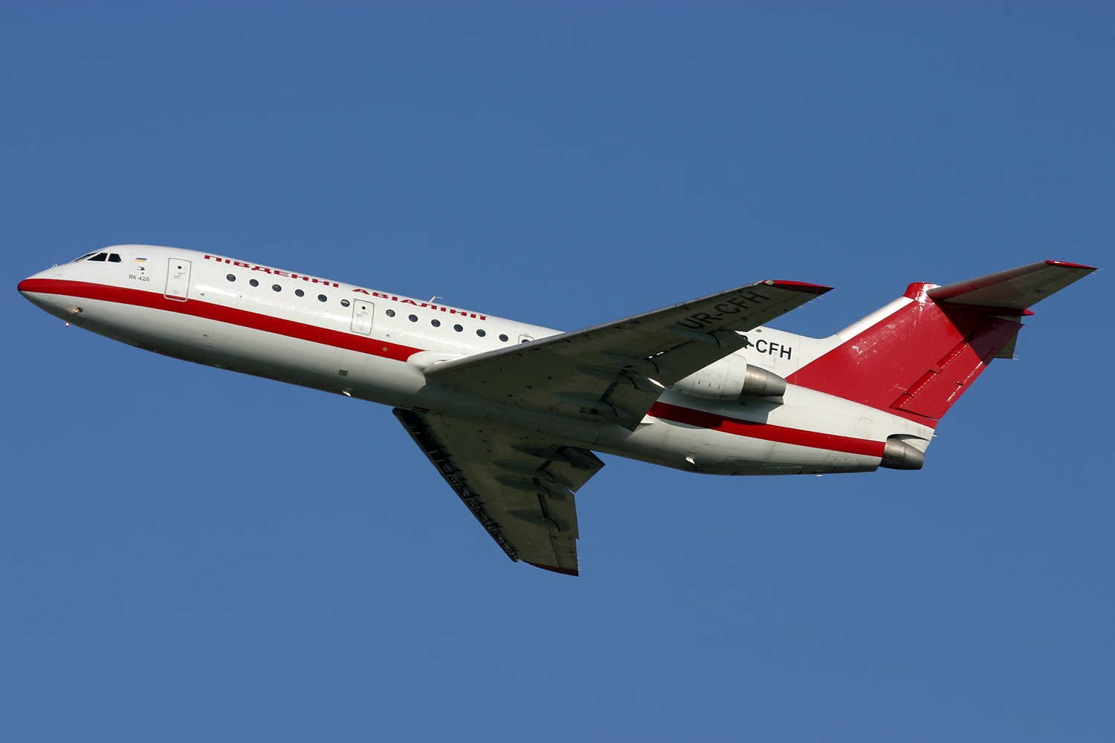

3. Methodology
Dataset: FGVC Aircraft. There are 10,000 images, each of them is a $3×299×299$ input. Each of train set, valid set and test set has about 3,333 images (standard split by the creators). We concern about variant label of each image, for example, we consider the following image as ‘Yak-42’, because it depicts a Yak-42 aircraft.
Figure 1: A sample Yak-42 aircraft

Slide 12
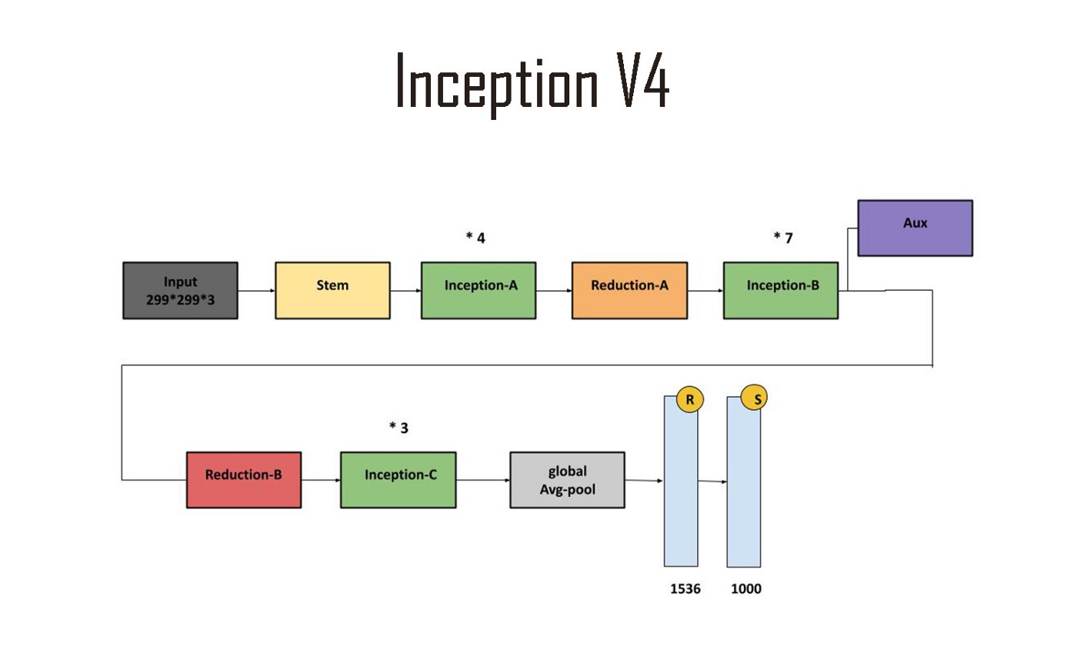
3. Methodology
Model: Inception V4
Metric: Top-1 accuracy
Computation resources: Tesla T4
Figure 2: General architecture of Inception V4

Slide 13
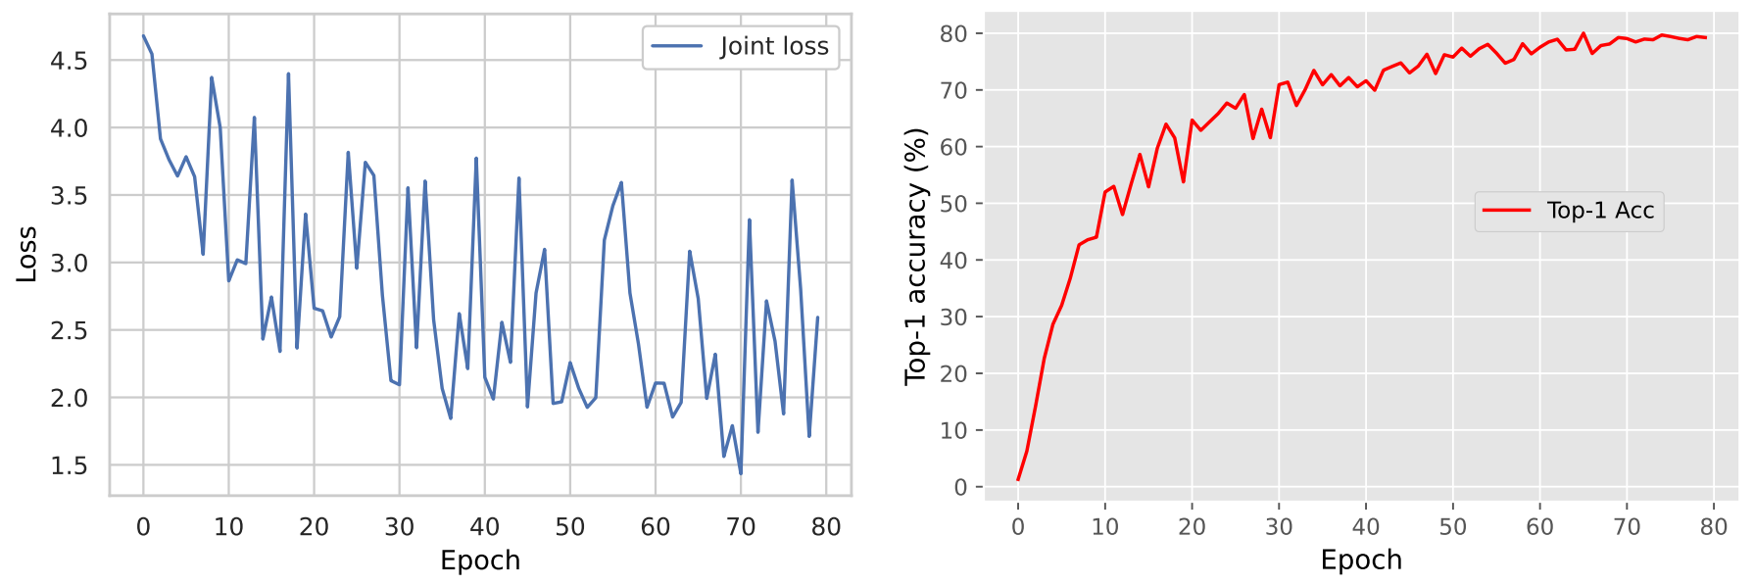
4. Experiments
Figure 3: Learning process of proposed methodology

Slide 14
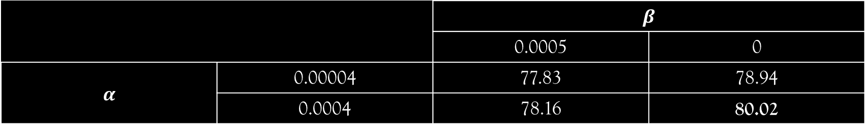
4. Experiments
 |  | $$β$$
 |  | 0.0005 | 0
$$α$$ | 0.00004 | 77.83 | 78.94
 | 0.0004 | 78.16 | 80.02
Table 1: Top-1 accuracy (%) by combination of $α, β$ (Equation 2)

Slide 15
5. Discussion
In this project, the author proposed a joint loss of L2SP-Fisher and L2SP and study the impact of L2SP-Fisher hyperparameters.
In the future, in order to achieve further improvements, the author will study the impact of other hyperparameters to proposed method.

Slide 16

Thank you for your attention!

